Slide 1
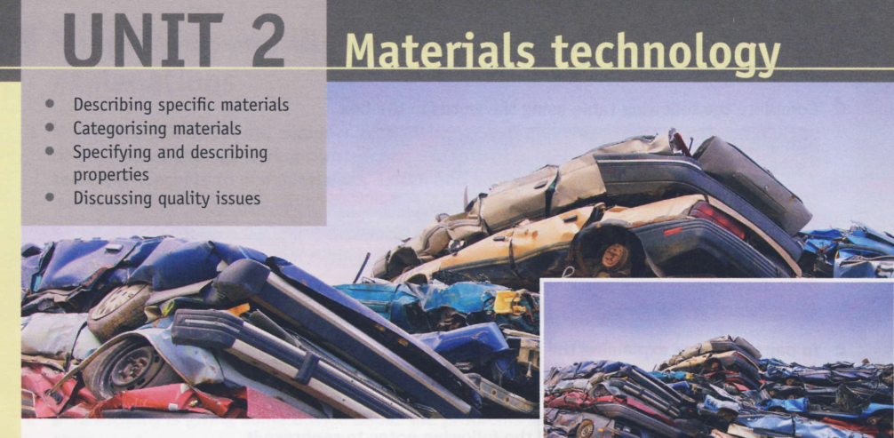
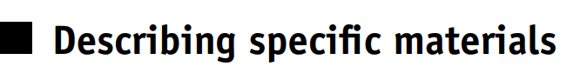

Slide 2
Increasingly, engineers need to design in recycling – planning for how assemblies will be disposed of.
Language note: The following vocabulary is useful in this section. aluminium, bronze, copper, glass, lead, iron, ore, plastic, rubber, steel, stainless steel, timber, hardwood, softwood, zinc, chromium, asbestos, insulation, asphalt, ironmongery,

Slide 3
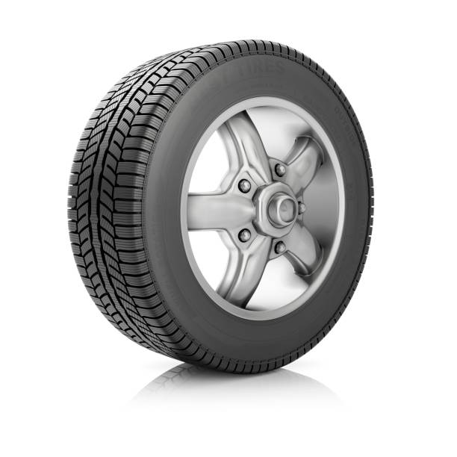
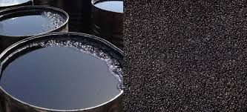
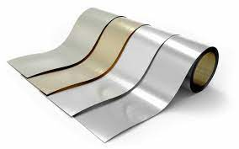
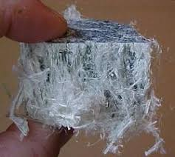
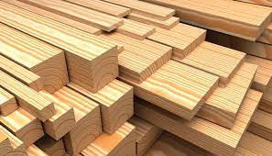
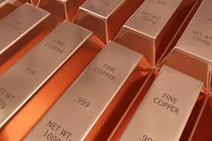
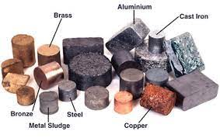
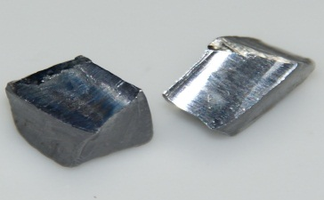
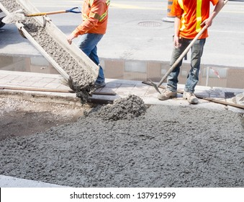
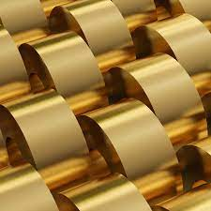

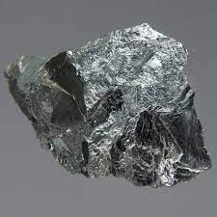
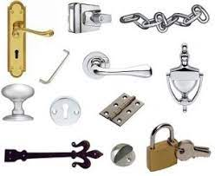

Slide 4
scrap = waste material intended for recycling alloy = a mixture of metals sometimes containing a non-metal, for example carbon (C) in steel brass = an alloy of copper (Cu), zinc and, often, lead (Pb) bronze = an alloy of copper and tin (Sn) melting down = using heat to change the state of a substance from solid to liquid energy-intensive = using a lot of energy electrolysis = passing an electrical current through a liquid or solid in order to separate chemical compounds ore = mineral from which metal is extracted hardwood = timber from deciduous trees softwood = timber from pine trees ironmongery = collective term for small metal items commonly used in buildings, for example door handles, hinges, screws, nails

Slide 5
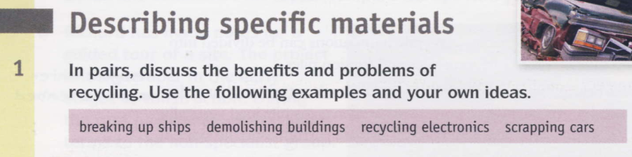

Slide 6
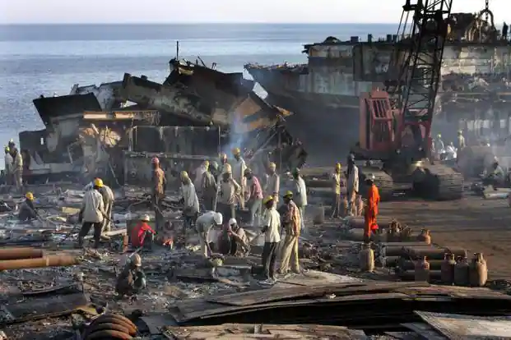

Slide 7
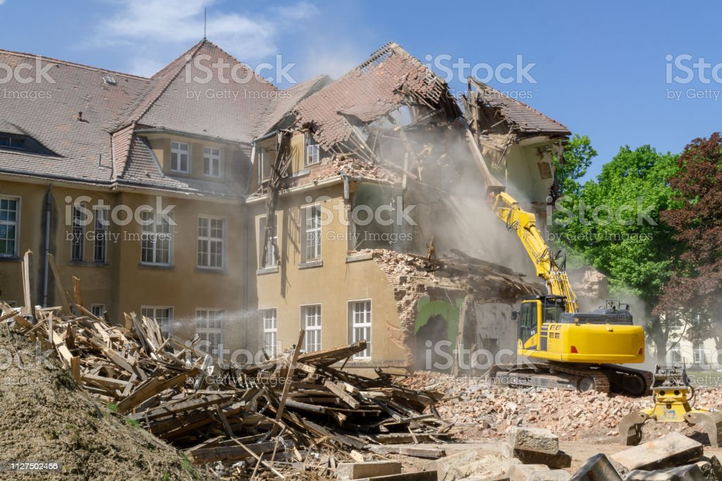

Slide 8
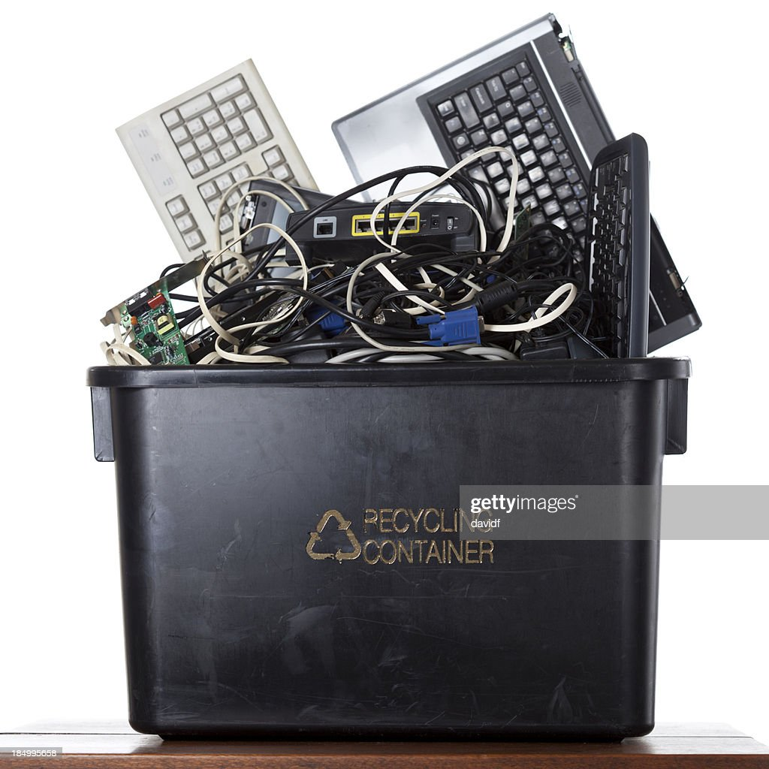

Slide 9
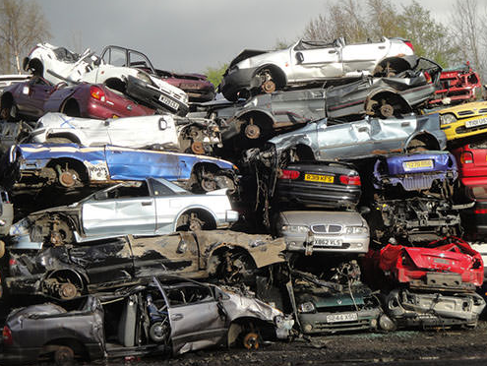

Slide 10
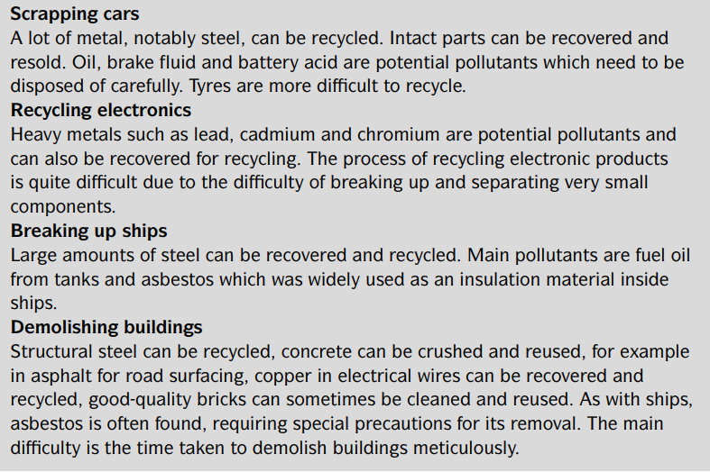
……………………..
……………………..
……………………..
……………………..

Slide 11
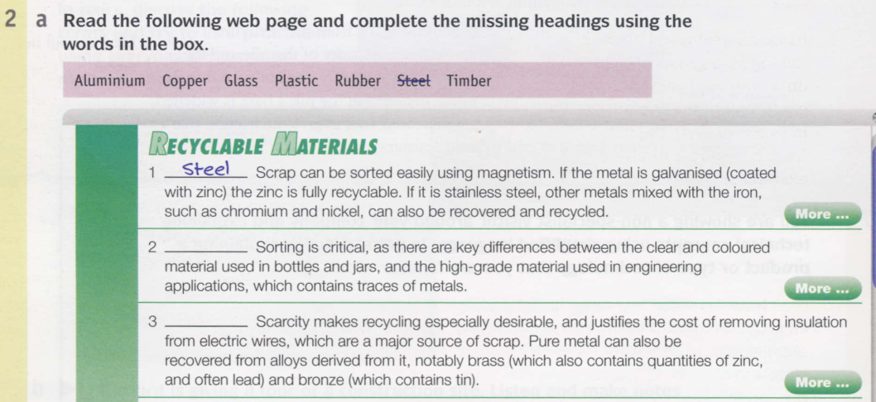

Slide 12
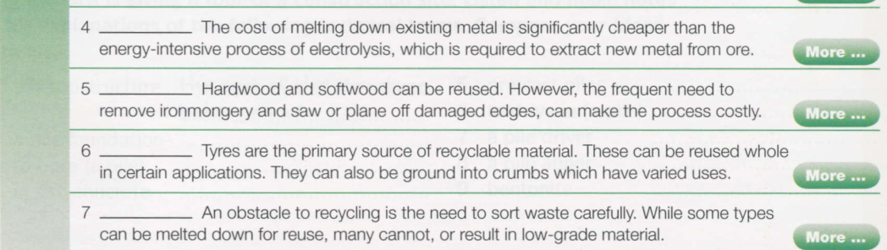

Slide 13
magnetism = force of attraction galvanised = coated with zinc (Zn) to prevent rusting recyclable = can be recycled chromium (Cr) and nickel (Ni) = metals added to steel to make stainless steel traces = small quantities scarcity = limited availability/rarity insulation = electrical insulation
wire = single strand of metal

Slide 14
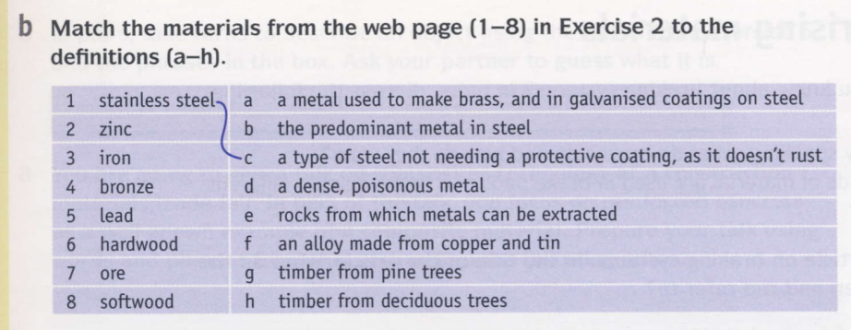

Slide 15
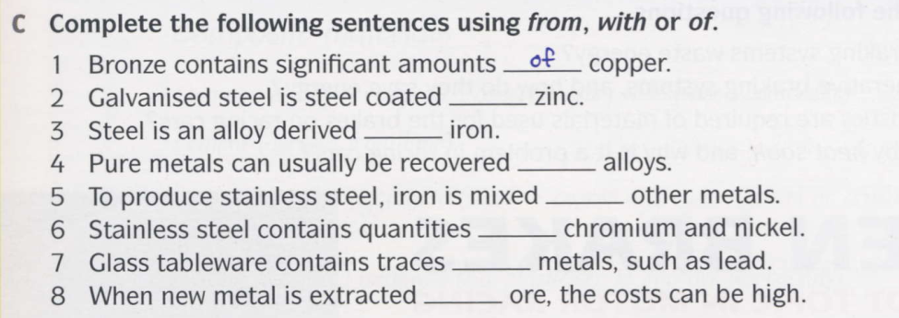

Slide 16
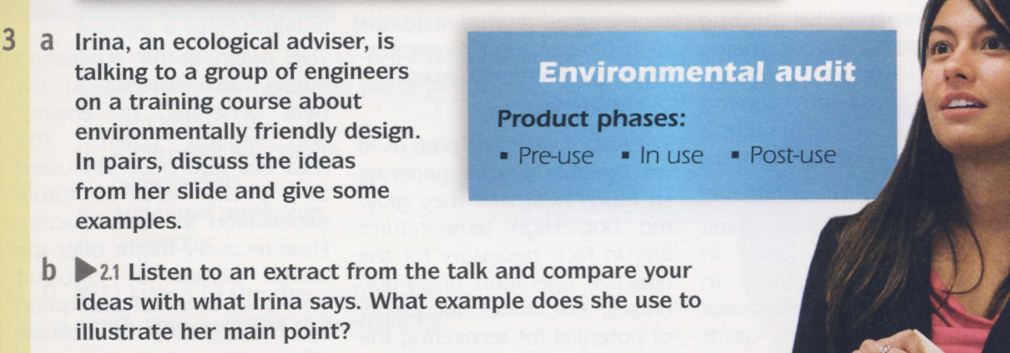

Answers The main point that Irina makes is that it’s important to consider the total environmental impact of a product, including producing it (pre-use), using it (inuse) and recycling it (post-use). She gives the example of an energy-saving light bulb.

Slide 17
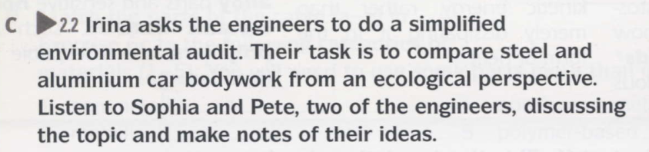
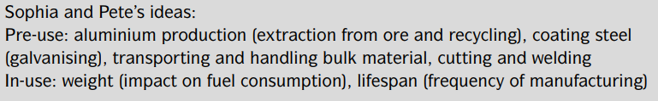

Slide 18
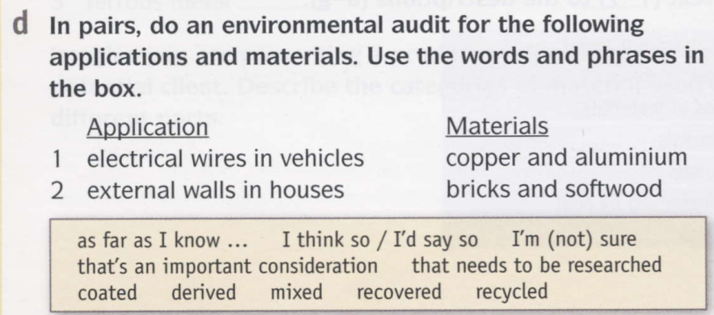

Slide 19
